Slide 1
Chapter 1
The Uniqueness of Software Quality Assurance

Slide 2
The Software Quality Challenge
This chapter is essentially about two major topics:
  The uniqueness of software quality assurance
  The environments for which SQA methods are developed.

Slide 3
The Uniqueness of Software Quality Assurance

Slide 4
Introduction
Why study Quality Assurance and Testing?
With all the methodology wars, numerous processes, huge number of tools to assist in software development.
What makes SQA important that it deserves so much attention?
SQA is a key required course in software engineering curricula. Why??

Slide 5
Major Differences between Software Products and Industrial Products
1. High complexity of the software product
  The potential ways in which a software product can be used with different data / data paths reflecting different incoming data is almost infinite.
  Manner in which industrial products can be used are usually much more succinctly defined.
    Parameters for use are usually clearly spelled out.
    Process for development clearly defined; prototype, …
  Think about software:
    every loop with different values of data reflects a different opportunity to see software fail.
    In truth, the number of paths through a non-trivial software product is infinite.

Slide 6
Differences between Software Products and Industrial Products
2. Invisibility of the software product
  In an industrial product, missing parts are obvious.
    Something missing? Easily identified. Clear ‘spot’ for it.
    Parts missing easily identifiable too.
  Not so in software products.
    May not be noticeable for years – if at all!
    Parts may have never been in the software ever!

Slide 7
Differences between Software Products and Industrial Products
Consider: Product Development and Production Process from three perspectives:
1. For Industrial Products:
  Product Development –
    Designers and QA people check / test the prototype for defects
  Product Production Planning –
    Here, production process and tools are designed and prepared.
    May require special production line to be designed and built
    Lots of opportunities to check for defects that escaped reviews and tests conducted during development
  Manufacturing –
    QA procedures are applied to detect failures of the products themselves during manufacturing.
    Can be corrected by change in the design or in production tools and this will change the way products are manufactured in the future.

Slide 8
Differences between Software Products and Industrial Products
Will see that:
  Comparing industrial products with software products we see that the only phase when defects can be corrected in software products is really in the product development phase.
Let’s look at the same three activities
  (product development, product production planning, and manufacturing)
for Software Products:

Slide 9
Differences between Software Products and Industrial Products
Consider: Product Development and Production Process from three perspectives
2. For Software Products:
Product Development – Best Chance to Detect Errors!
  Here, we look for inherent product defects and hope to arrive at an acceptable prototype.
Product Production Planning
  This phase is not required for software production process.
  Copies are simply reproduced / printed automatically….
  Numbers of copies of no consequence.
  Defects in one copy are found in additional copies. End of story!
Manufacturing
  Manufacturing limited to copying product / printing copies of manuals.
  Chances for detect defects here is quite limited.

Slide 10
Only Chance to Discover Defects:
Best chance to really detect defects occurs during the software development process itself!
“The need for special tools and methods for the software industry is reflected in the professional publications as well in special standards devoted to SQA, such as ISO 9000-3, “Guidelines for the application of ISO 9001 to the development, supply, and maintenance of software.”
Another: ISO 9004-2: “Quality Management and Quality Systems Elements: Guidelines for the Services.”
The characteristics of software –
  complexity,
  invisibility, and cu
  limited opportunity to detect bugs
has led to the development of the ISO Guidelines and an acute awareness of the importance and essential SQA methodology.

Slide 11
The Environment for which SQA Methods are Developed
Let’s look at the environment for professional software development and maintenance
Main Characteristics: (We will look at each of these in turn)
  1. Contractual Conditions
  2. Subjection to Customer – Supplier Relationship
  3. Required Teamwork
  4. Cooperation and and coordination with other teams.
  5. Interfaces with other software systems
  6. The need to continue carrying out a project despite team member changes
  7. The need to continue carrying out software maintenance for an extended period.
These are ALL activities where SQA in various forms is critical to successful software engineering work

Slide 12
The Environment for which SQA Methods are Developed
1. Contractual Conditions
  These include functional requirements, the project budget, and the project timetable.
  Contracts are huge
  Who has responsibility for what…we will see.
  Delivering software on time, within budget that meets or exceeds the functional requirements constitutes the thrust and legal elementsof contracts.

Slide 13
The Environment for which SQA Methods are Developed
2. Subjection to Customer-Supplier Relationship
  We must realize that the customer drives the process in many cases – submitting changes, evaluating deliverables, acceptance testing, approving the deliverables
    This relationship must be generally good, but can be horribly complicated!!
  This is the relationship that is critical when software is developed by software professionals.
    Many war stories available!

Slide 14
The Environment for which SQA Methods are Developed
3. Required Teamwork
  Three very motivating factors for teams vice done individually:
    Timetable requirements – team members work together
    Have a variety of specializations – Discuss. Always necessary? Where? When?
    Mutual support and review to enhance product quality

Slide 15
The Environment for which SQA Methods are Developed
4. Cooperating and coordination with other software teams
  In a large software development organization, there are many teams and much development that requires coordination and compatibility issues
  Expertise may exist in another team.
    Can you borrow that person? That expertise?
  Software development may outsourced in part.
  Other teams may have developed similar software for the client and can offer tremendous help – perhaps…
  Conflicts

Slide 16
The Environment for which SQA Methods are Developed
5. Interfaces with Other Systems
  A Course Registration System – may well interface with a Class Scheduling System and perhaps a Billing System.
  Oftentimes outputs from one system are inputs to another and vice versa!
  A course registration system may need to ‘interface’ with an existing Billing system with different file / database formats, and more.
  Sometimes outputs from one system are inputs to several others
  Or, outputs from some system update master files / databases that are processed by other systems.

Slide 17
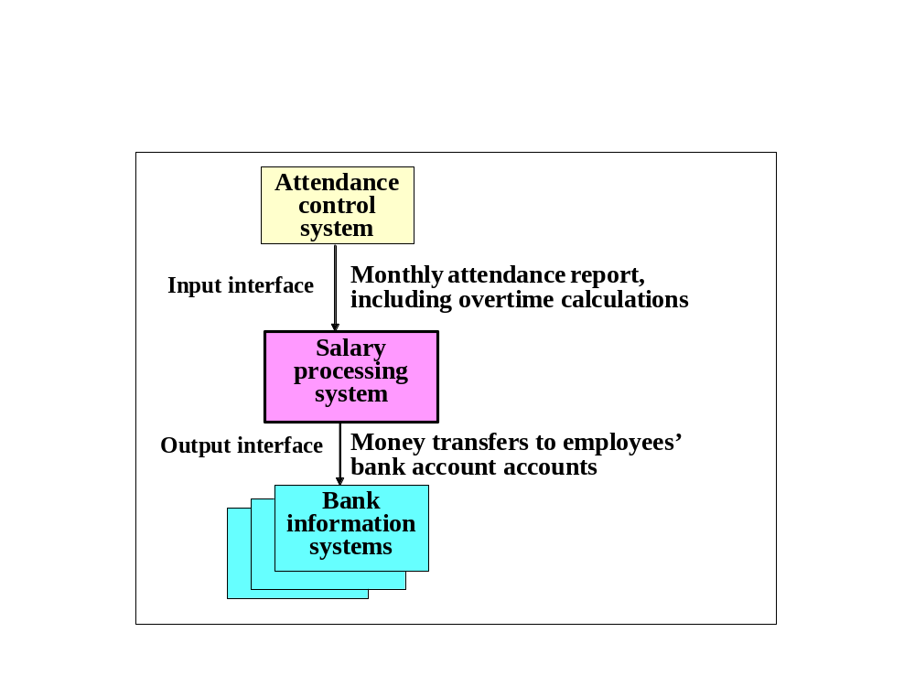
The Environment for which SQA Methods are Developed

Slide 18
The Environment for which SQA Methods are Developed
6. The Need to continue Carrying out a Project despite Team Member Changes
  Very commonplace! Count on it!
  “The show must go on”
  Fred Brooks: Adding people to a late project makes it later.
  Fred Brooks: Communications with new members
  Fred Brooks: Getting new people up to speed.
  Team members leave, are hired, fired, take unexpected vacations, transferred within the company, and more.
  Maddening truism, but the development must continue.
  You can count on disruption!

Slide 19
The Environment for which SQA Methods are Developed
7. The Need to Continue Carrying out Software Maintenance for an Extended Period
  Software is developed to run for years.
    This is what affects the company’s bottom line – not software development, where the company is totally in the ‘red.’
  Maintenance is good and is where software development corporations make their money.
  Remember, when developing software, company is in the ‘red.’
  Takes some time after deployment for transition into the black and make revenue.

